Slide 1


Advancing Equity from New Angles: A Multi-Dimensional Approach to Accessibility and Reliability with Citi Bike NYC Case Study
NYU x SEMPACT Workshop
Zilin Bian, Enola Ma, Jingqin Gao, Hai Yang, Joseph Chow, Kaan Ozbay
September 20th, 2024

Slide 2

Initial Findings - Practitioners
Existing tools and resources focus on screening for areas/ locations suitable for transportation equity-related projects
However, these tools often lack project evaluation components, especially for post-project evaluations
Need more evaluation tools

Slide 3
Initial Review Summary
Federal tool (ETC Explorer)
  Use many metrics and combine them into component scores for four topics, then arrive at a final composite index
  However, may overlook individual metrics:
    Component score not meeting flagging criteria for Area A, and therefore, not considered disadvantaged for that topic
    Low service frequency, while initially considered as a metric for the component score, is now overlooked
MPO/Local agency tools
  Not all screening tools have an evaluation counterpart
  The evaluation tools have different purposes
    Mostly cover needs assessments and identify potential impacts of proposed projects
    But often lack metrics and guidelines for post-implementation progress evaluation
  At the time of the review, NYS did not have a transportation-specific equity screening or evaluation tool
Notes:
Only showing etc explorer for federal cuz the other tool reviewed wasn’t specific for transportation
“Screening” here refers to narrowing down areas for potential project implementations
“frequency of transit services per sq mi” measure in etc explorer come from epa smart location databased 2021, and uses a static measure: number of services per hour between 4 and 7pm instead of dynamic hourly throughout the day

Slide 4
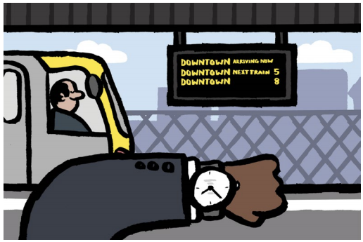
Initial Findings - Academia
Focus mostly on accessibility provided by transportation service infrastructure, or access to the service
Issues arising from this approach:
  Person A: 15 min walking distance from train station, train comes every 7 min
  Person B: 2 min walking distance from train station, train comes every hour
Need to incorporate service availability/ quality

Slide 5

Research Motivation
Create an evaluation tool for transportation service projects that combines destination accessibility with service performance, and incorporate synthetic population data with high granularity
  Multi-dimensional, High-granularity
  (MDHG) Equity Index

Slide 6
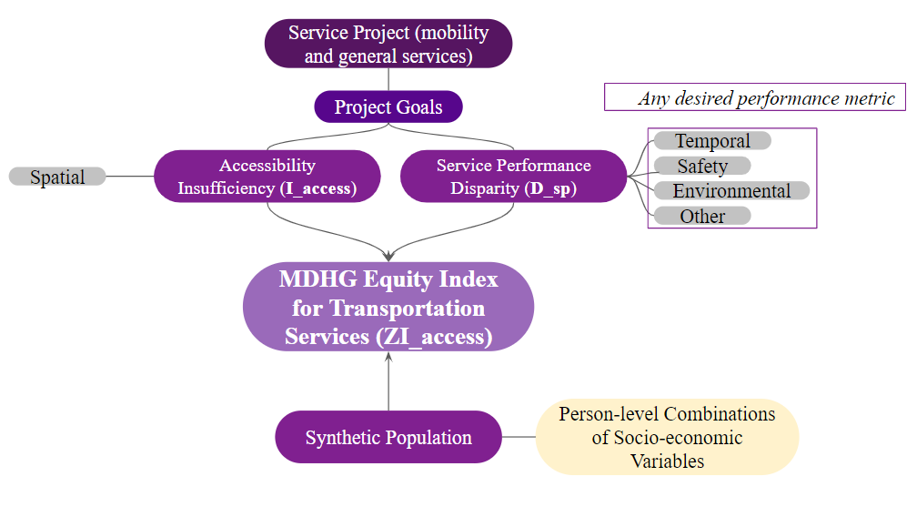
Proposed Framework Overview
Notes:
Example project: accessible train stations
Project goals: #x of accessible stations per NTA
Accessibility insufficiency: area reached (destination coverage) by service provided accessible stations (origin); similar to i_acc in our citi bike case study
Service performance disparity: some accessible stations have elevators out of service, while others have decent elevators

Slide 7
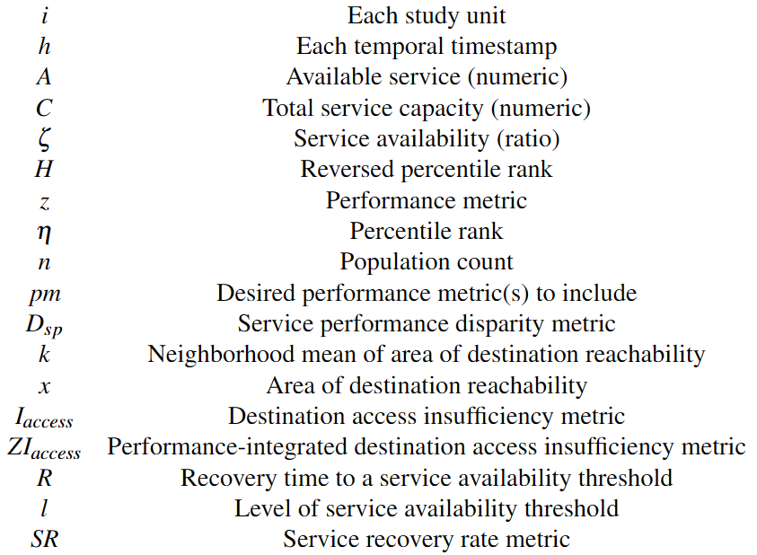
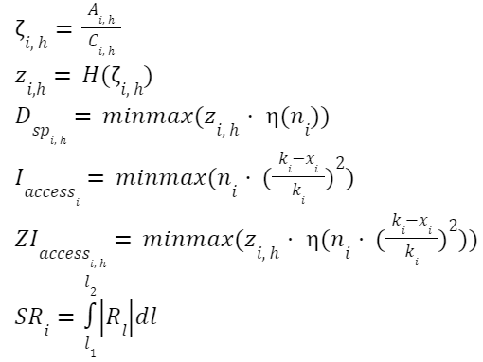
Proposed Methodology

Slide 8
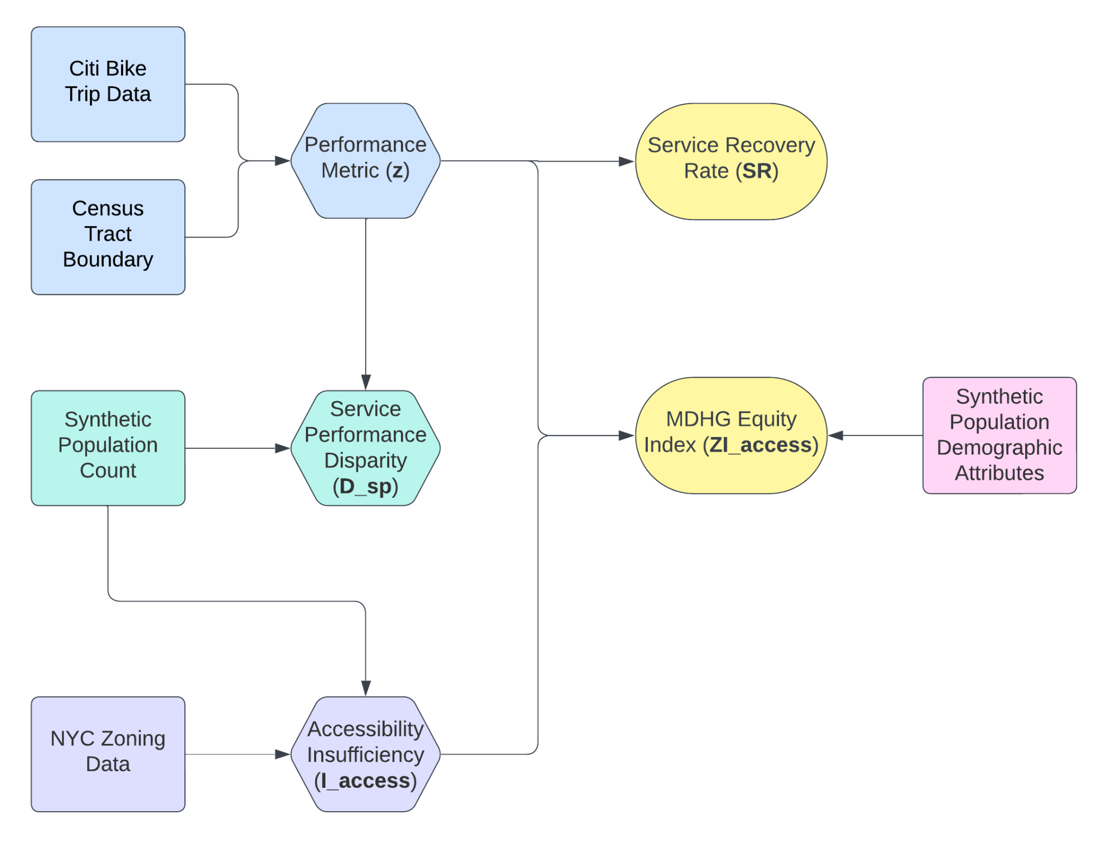
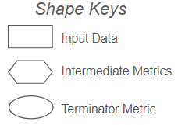
Case Study Application Overview
Note:
I_access and ZI_access separated into commute and recreation zones based on zoning designations
Many metrics are the min-max normalized product of percentile ranks
Aside from the unranked performance metric, a higher score means bad for all the other metrics
Most metrics range between 0 and 1

Slide 9

Other Applications
Public transit service modifications
  New stations, reduced service delays, accessible facilities, etc.
Electric vehicle charging stations
  New charging ports, improved charging speed, etc.
Essentially, any transportation service that need to be maintained

Slide 10
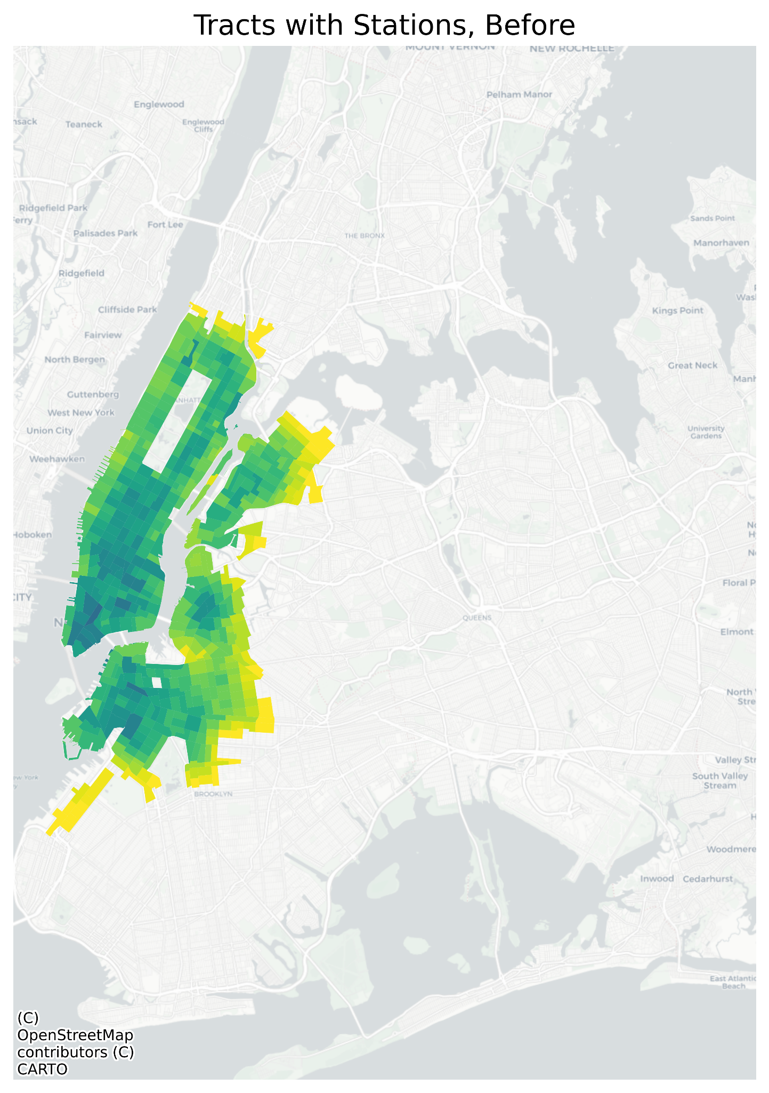
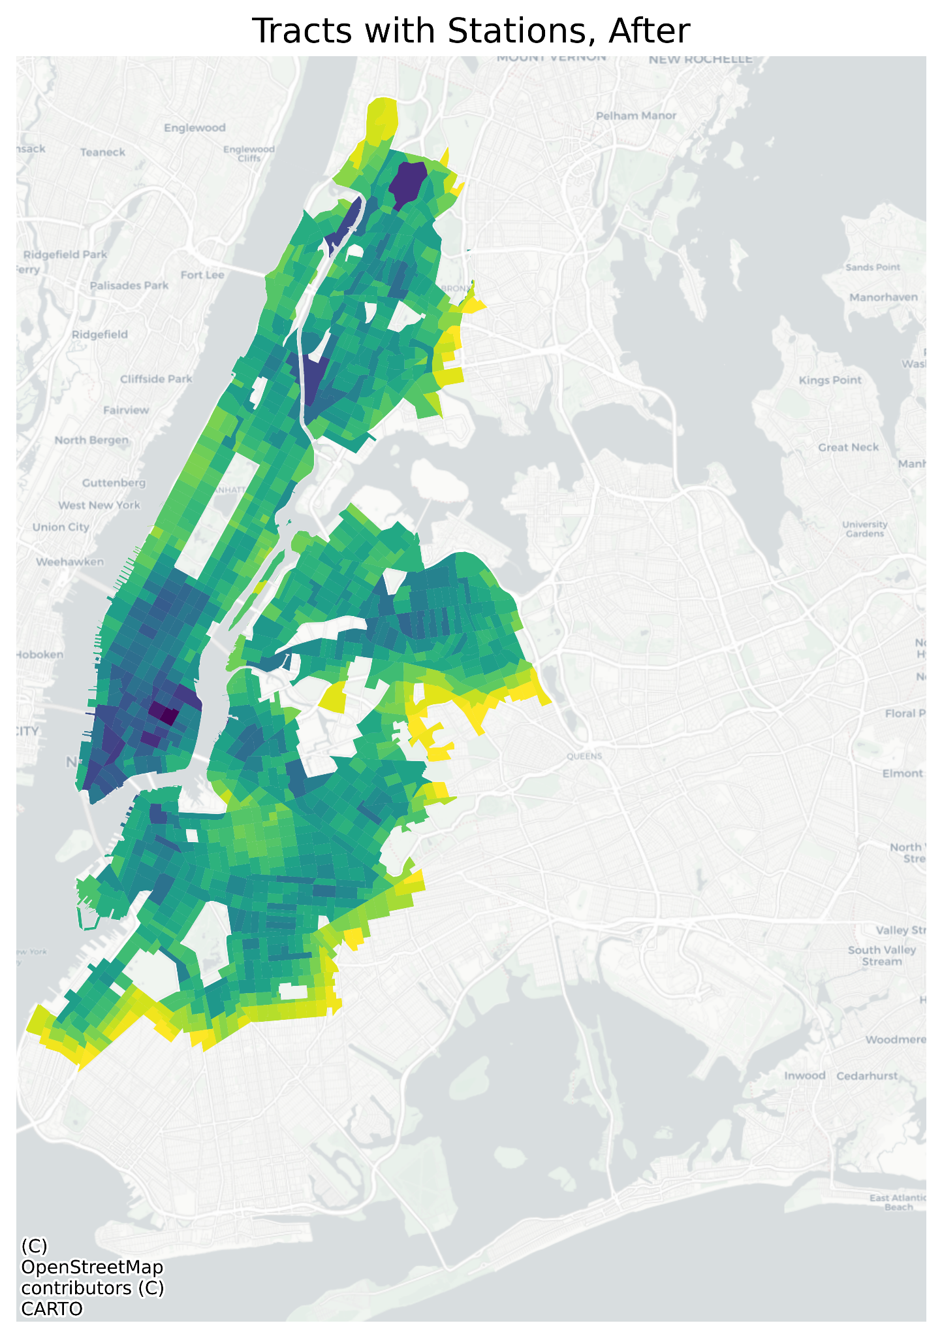

Citi Bike service scale increased drastically from 2018 to 2024

Slide 11
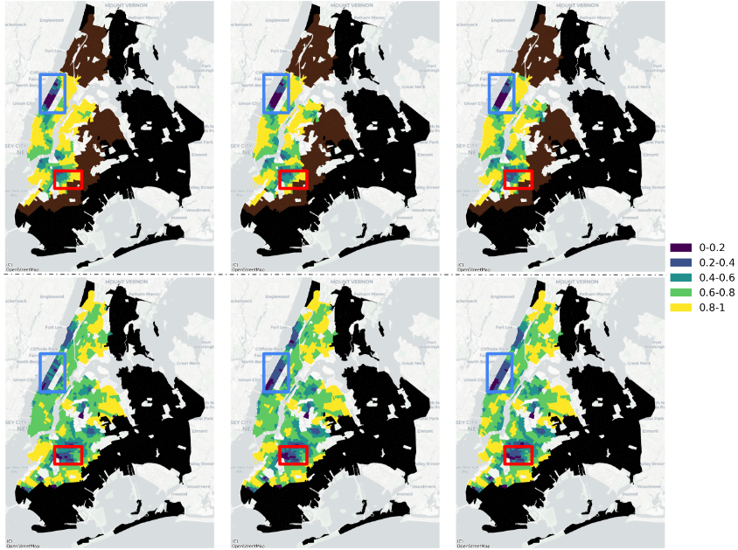
Raw performance metric (ζ) map
Top row: before
The snippet of three hours (0, 8, 16) shows that the performance metric varies throughout the day
Overall, the minimum service availability of bikes improved during the expansion period
However, not all areas showed improved service availability after the expansion
In addition, more tracts have moderate service availabilities (0.6+) instead of perfect (0.8+)
Notes:
Z_raw

Slide 12
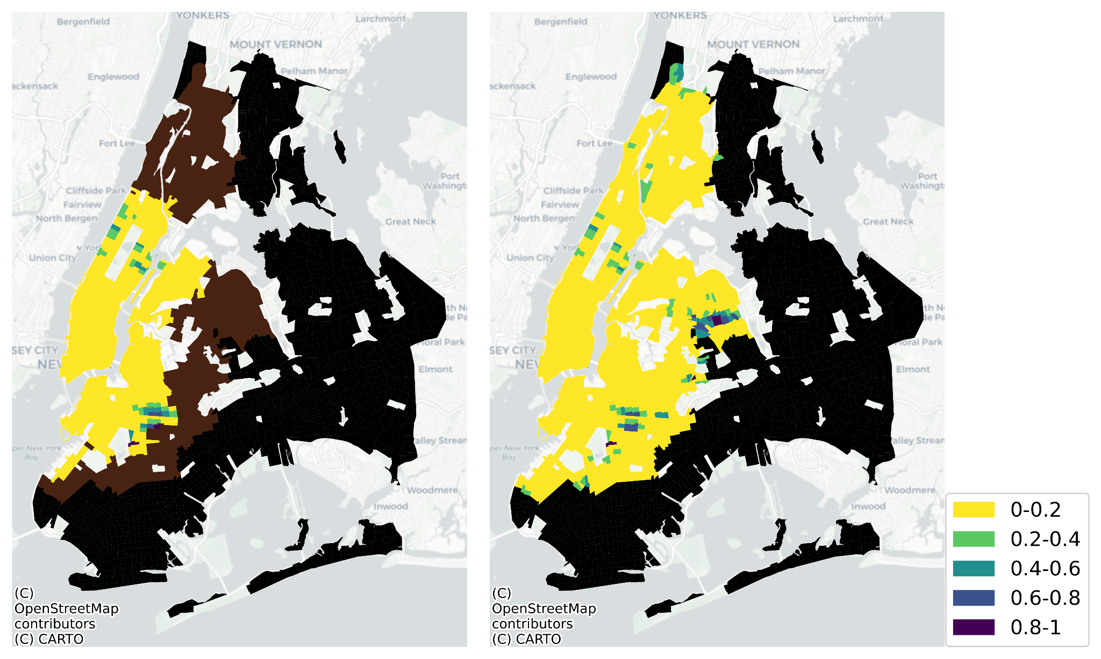
Accessibility insufficiency (I_access) for commute zones
Left: Before
Areas with high commute zone I_access scores are primarily residential heavy
Notes:
I_acc, commute, bef vs aft
skipping all recreational slides due to time limit

Slide 13
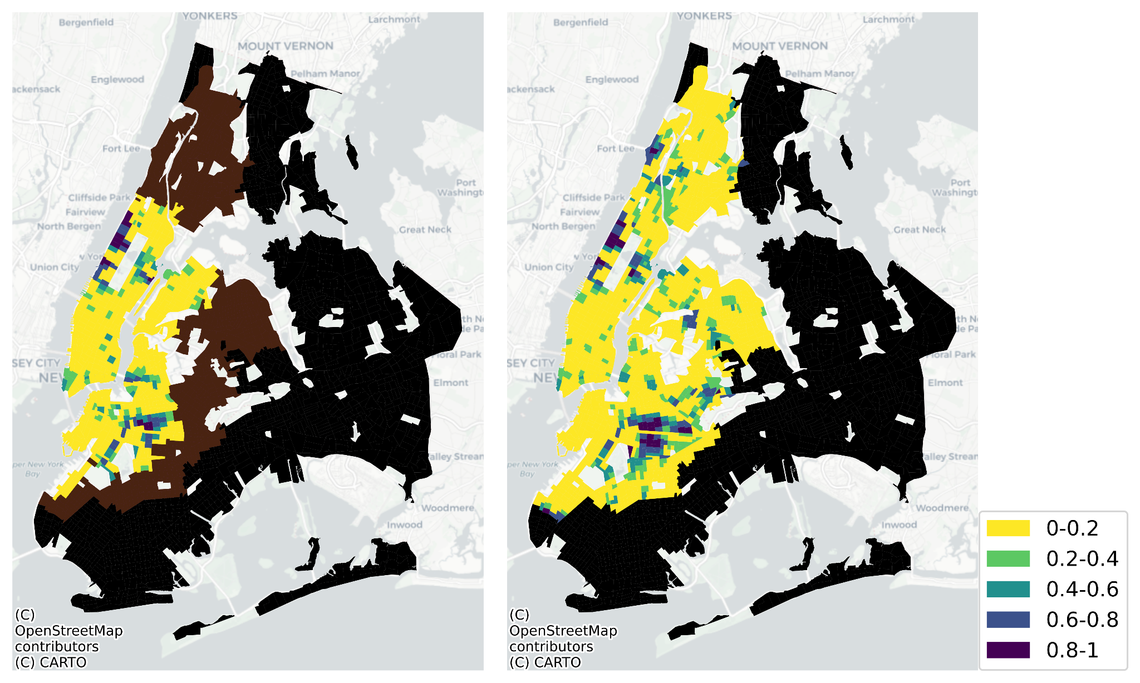
Performance-integrated accessibility insufficiency (ZI_access) for commute zones at 8AM
Left: before
Highlight: Bed-Stuy saw worsened score after the expansion due to decrease in service quality
Notes:
zi_acc, com, 8am, bef vs aft

Slide 14
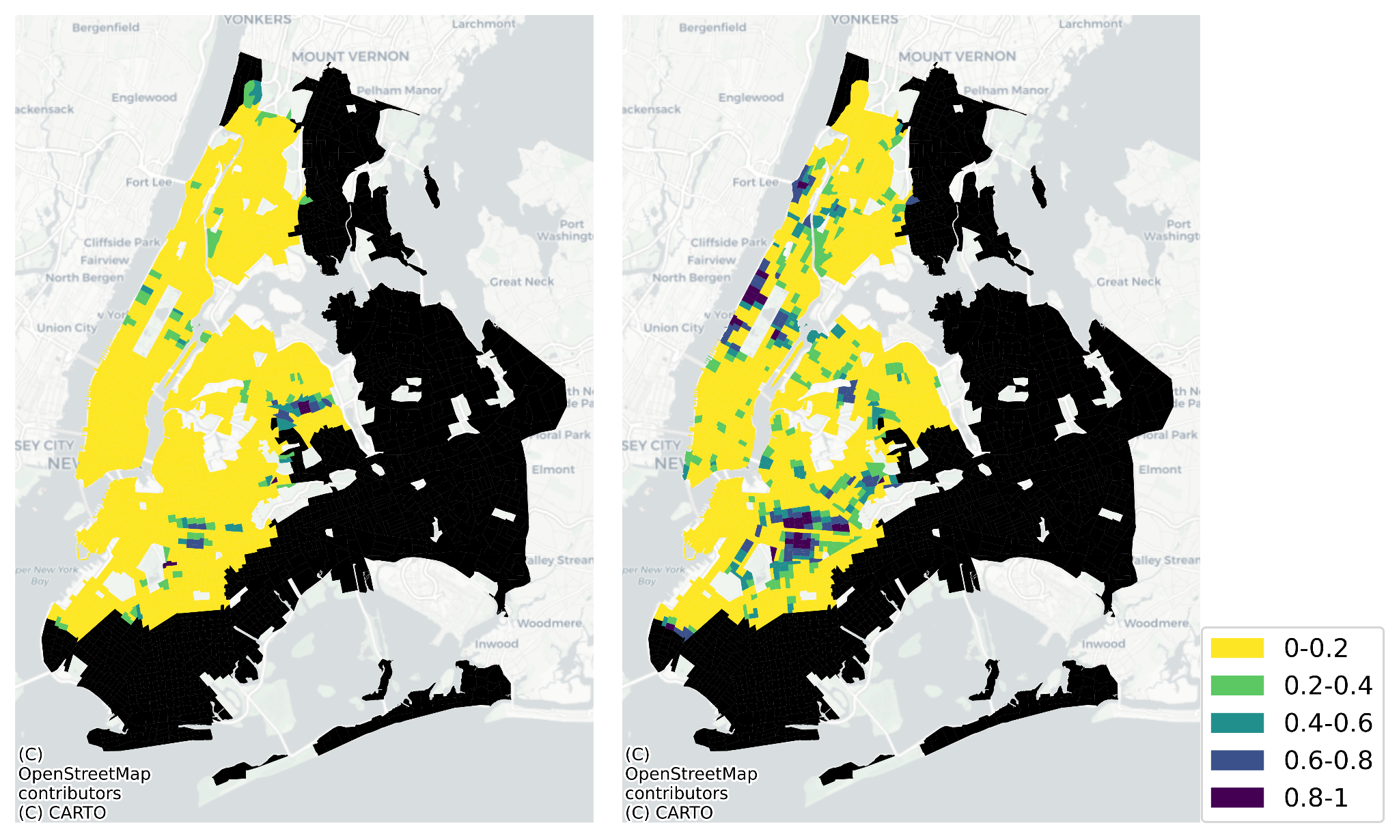
Performance-integrated accessibility insufficiency (ZI_access) and regular (I_access) comparison for commute zones
Left: I_access
The difference between the two emphasizes that sufficient access is not guaranteed when service availability varies
Notes:
I_access vs ZI_access, com, 8am, aft

Slide 15
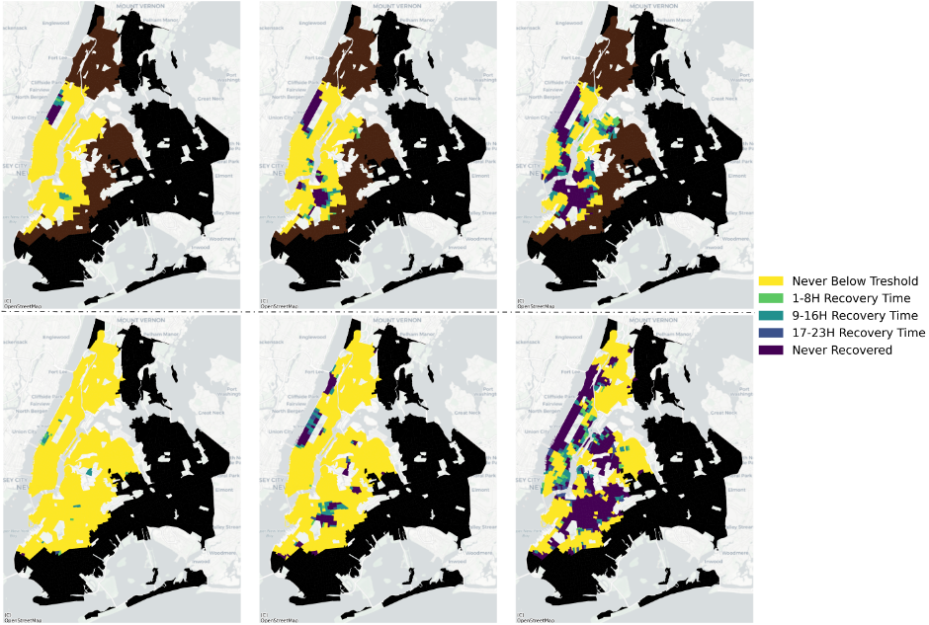
Recovery time (R) for three availability thresholds (0.4, 0.6, 0.8)
Top row: before
Customizable threshold to reflect “ideal service”

Slide 16
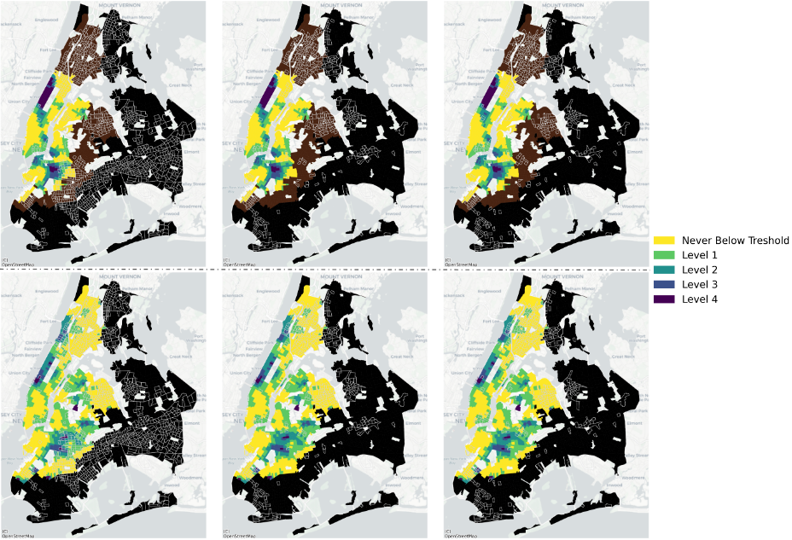
Service recovery rate (SR) with population overlays created using “at or above 75 percentile” of demographic criteria
Top row: before
From left to right: 1) race, 2) race, poverty, limited English, 3) race, poverty, limited English, no vehicle, unemployed
The Bronx had the highest number of combination demographic tracts, but low SR values indicate consistently good service availability
Before and after comparison shows overall improved system rebalancing

Slide 17
Policy Implications
Consider the temporally variating service performance/ quality
  Access to service facilities does not guarantee excellent service quality
More detailed demographic data is necessary to identify specific population segments for equity-related analysis
  Two groups with similar accessibility and service quality may have different sets of alternative options
Incorporate additional spatial-temporal data, such as detailed person-level trip data to enhance the understanding of stakeholders’ unique needs
  Design more tailored and responsive transportation services that better meet the diverse needs of the population

Slide 18
Table 1. Statistics of SR values comparing different populations, after the expansion
Combination | μ, disadvantaged | μ, not disadvantaged | p, t-test | p, ks-test
Race | 1.3106 | 1.8362 | 0.0 | 0.0
Race, Poverty, Limited English | 0.7889 | 1.5346 | 0.0 | 0.0
Race, Poverty, Limited English, No Vehicle, Unemployed | 0.8460 | 1.5197 | 0.0 | 0.0
Table 1 shows that SR values are significantly lower for disadvantaged population groups in the expansion zones

Slide 19
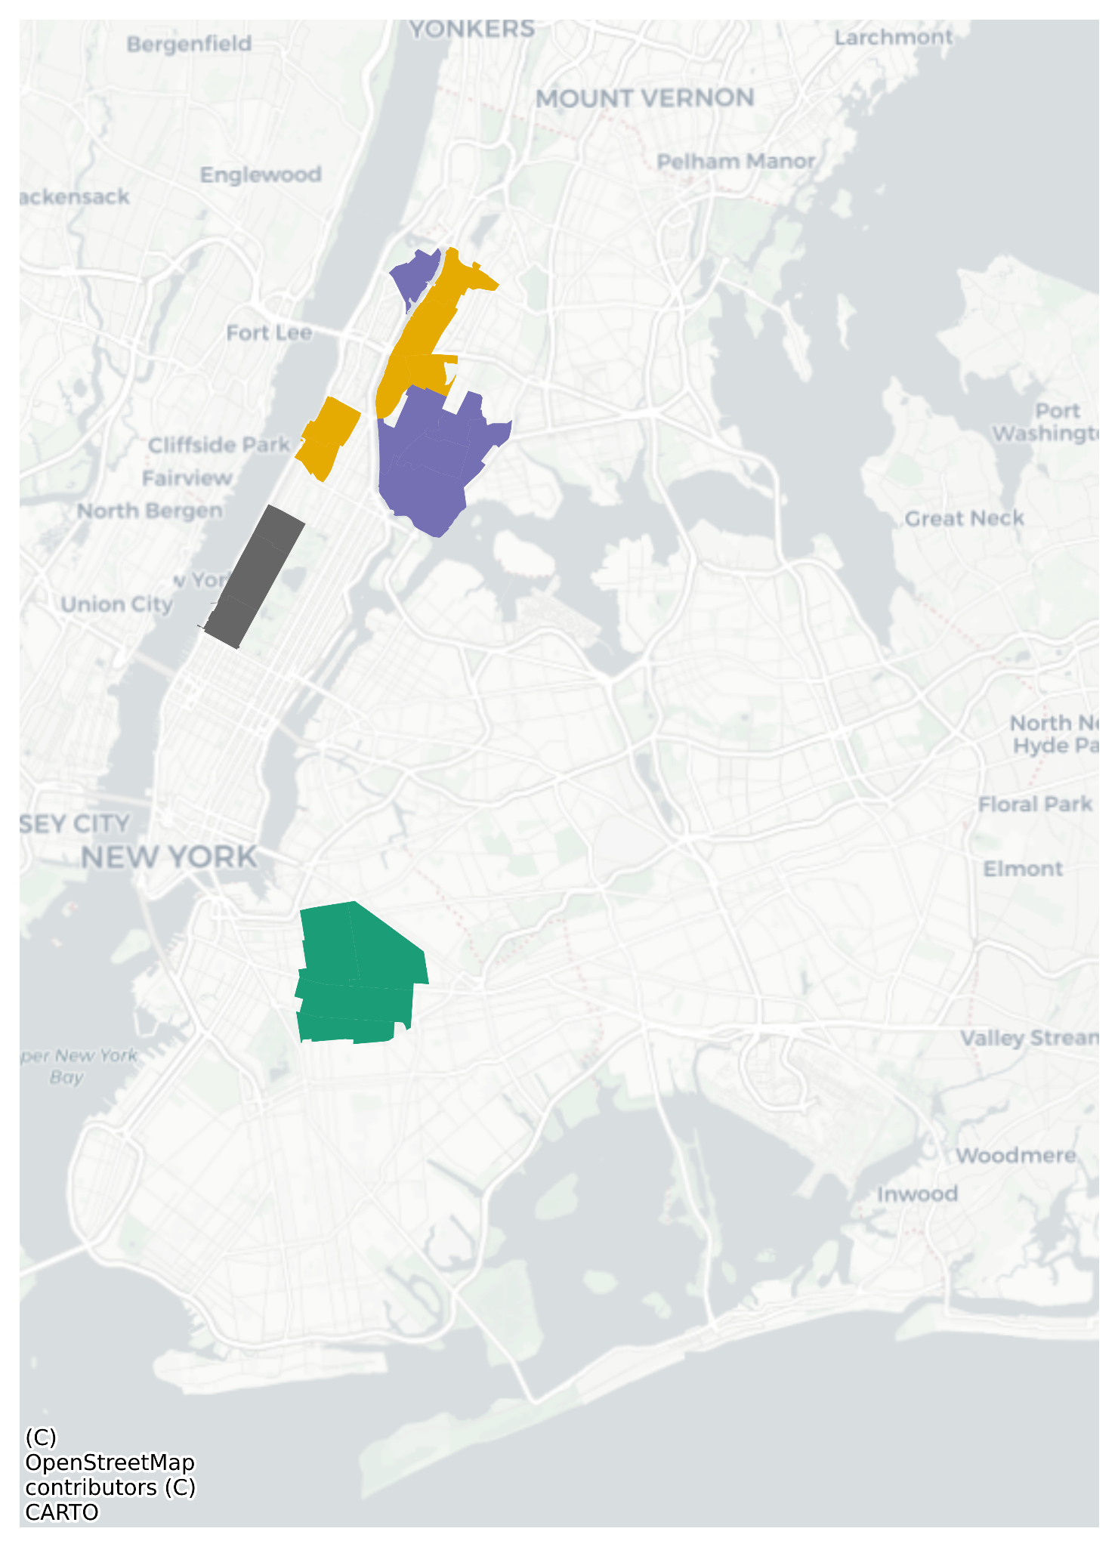
Selected 7 NTAs in UWS, Bed-Stuy, and Crown Heights with relatively low service availability in both periods
  UWS: Gray
  Bed-Stuy and Crown Heights: Green
Selected 12 NTAs in the Bronx and upper Manhattan to evaluate the supply and demand after the expansion
  Purple: consistently high availability (0.8+)
  Yellow: moderate availability (0.4-0.6)

Slide 20
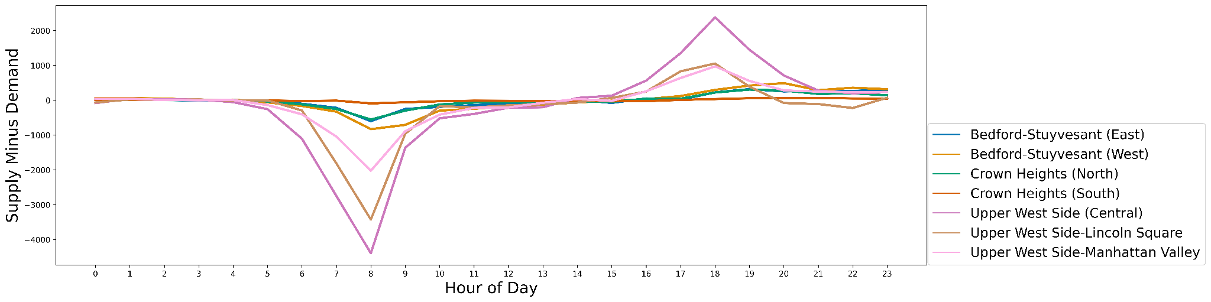
Before the expansion, using 8AM as example, the negative surplus was almost twice the positive for UWS, Bed-Stuy, and Crown Heights
Notes:
Uws: gray
Bed-stuy/ crown heights: green

Slide 21
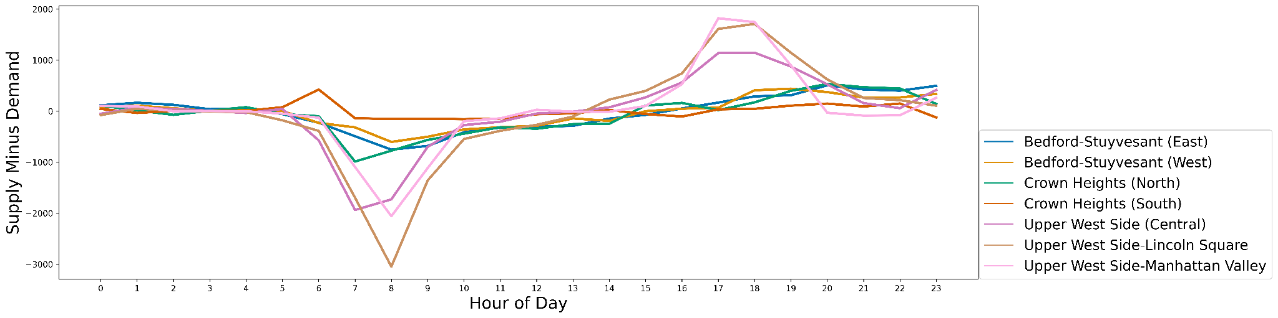
After the expansion, using 8AM as example, negative surplus improved for UWS (+31%), but worsened for Bed-Stuy, Crown Heights (-11%)

Slide 22
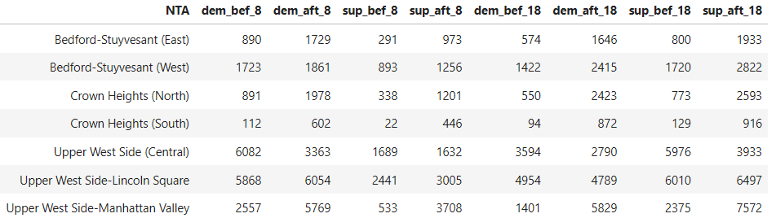
Trip counts for 8AM show that ridership increased in Bed-Stuy and Crown Heights (+129%), and UWS (+26%)
Notes:
increased ridership for bed-stuy/ crown heights combined with worsened negative surplus: better rebalance is necessary for these two areas in bk

Slide 23
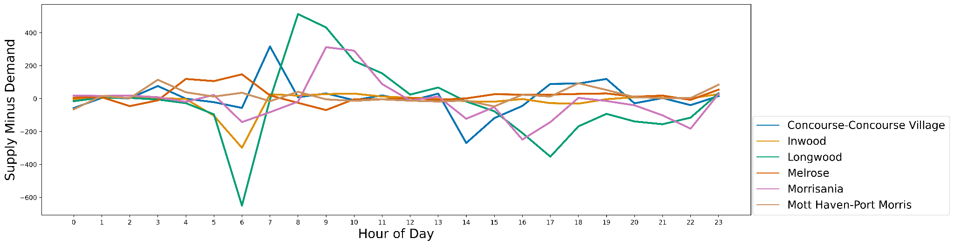
These 6 NTAs in the expansion zone have 80% full racks at all time
(purple on the map)

Slide 24
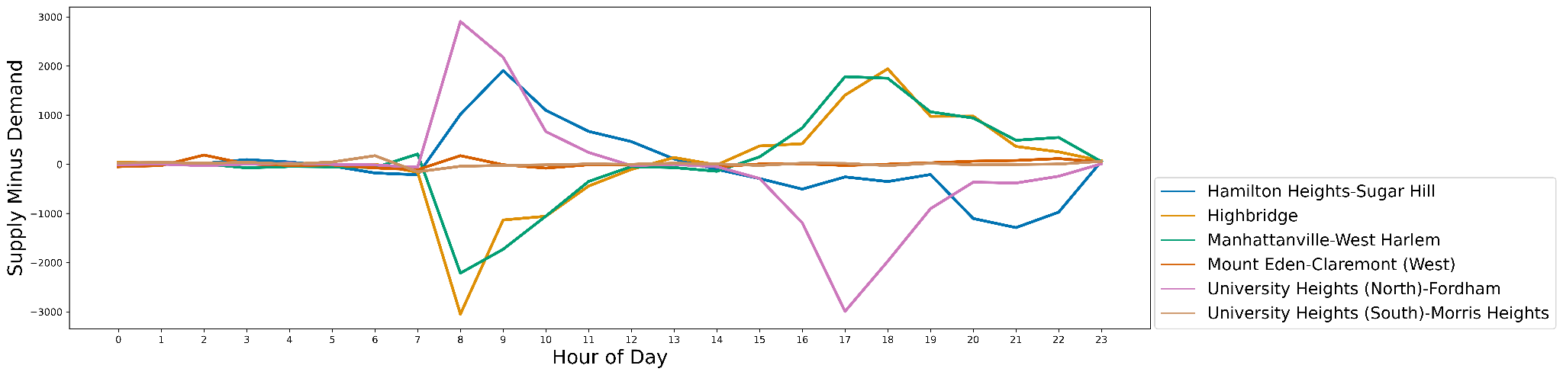
These 6 NTAs in the expansion zone have availabilities between 40% to 60%, more towards the latter (yellow on the map)
Notes:
Yellow on map

Slide 25
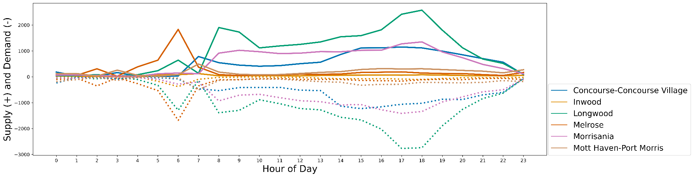
Among the 6 NTAs with good availability (purple on the map), everywhere besides Inwood and Melrose had comparable usage to Bed-Stuy.
Yet, their supply and demand almost always balance out
Notes:
these areas in the expansion zone shown here are much more balanced compared to bed-stuy

Slide 26
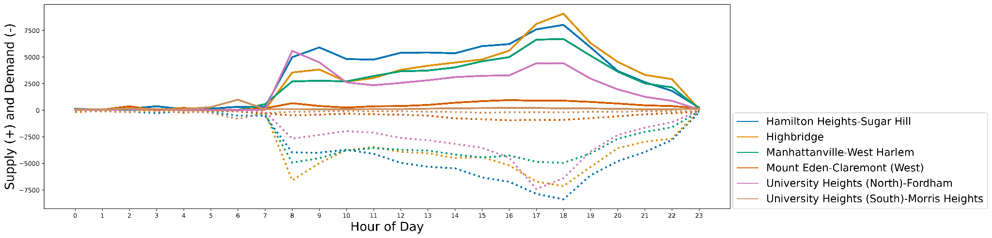
These 6 NTAs in the expansion zone with moderate availability (yellow on the map) between 40 to 60% had comparable usage to UWS.
Yet, their supply and demand are much more balanced
Notes:
these areas in the expansion zone shown here are much more balanced compared to uws
Yellow on map

