Slide 1

Synthesizing New York State Population
A Population Synthesis
Model Combining Statistical and Generative Models for Consistent and Diverse Household and Personal Attribute Association
Hai Yang, Hongying Wu, Linfei Yuan, Xiyuan Ren. Joseph Y. J. Chow, Jinqin Gao, Kaan Ozbay
C2SMARTER Center
New York University Tandon School of Engineering

Slide 2
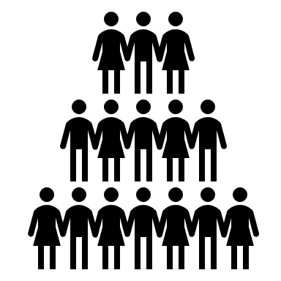
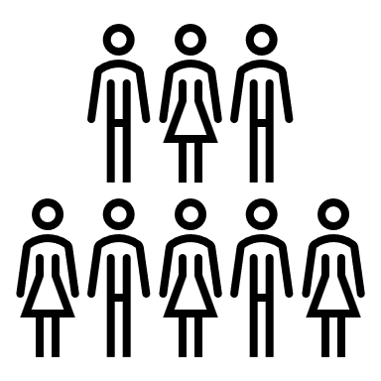


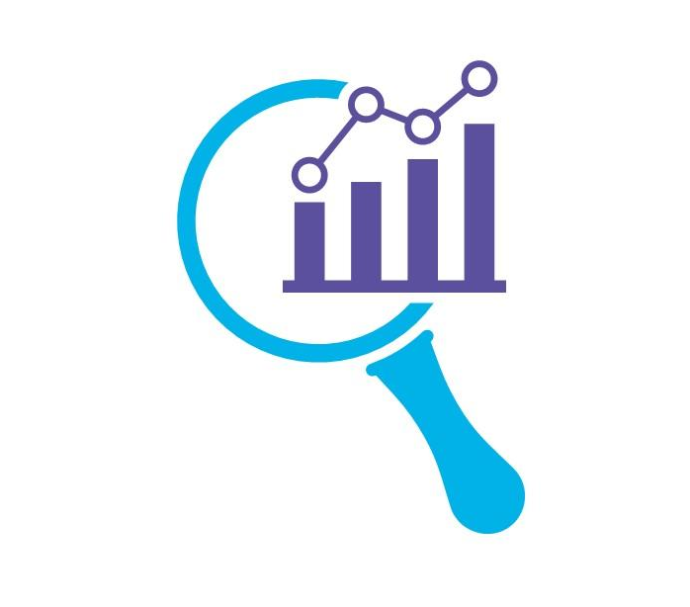









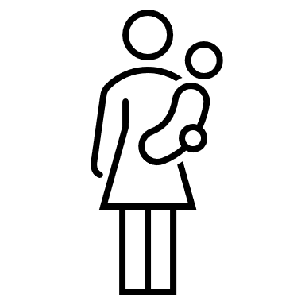


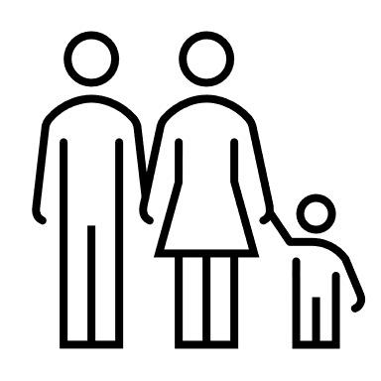


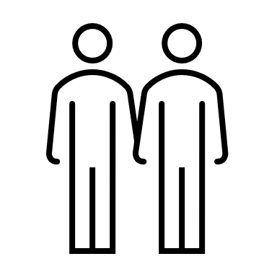




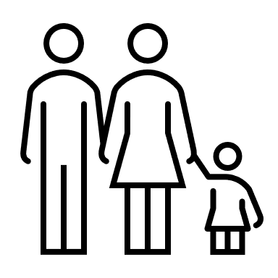
Introduction
What is a synthetic population?
A synthesized dataset that mimics the characteristics of a real population.
Created by expanding a small sample of individuals or households to match the demographic distribution of a larger population.
Synthetic populations are used when privacy concerns prevent full access to actual data.
Why synthetic populations are important?
Key for urban planning, transportation studies, and equity analysis.
Provides detailed demographic data, compensating for limited real-world datasets.
Supports agent-based models and policy evaluations with granular details.

Slide 3
Challenges
Out-of-sample Limitation (traditional methods)
Traditional methods (e.g., iterative proportional fitting (IPF)) replicate input samples to match marginal distributions, assuming the input sample represents the entire population
Cannot generate out-of-sample observations, restricting their ability to reflect real-world diversity.
Curse of Dimensionality (traditional methods)
High-dimensional data makes the multivariate distribution overly complex
Requires high computational effort, sometimes impossible
Overfitting and Prone-to-Bias (machine learning methods)
Less control over the generation process
Could magnify the existing bias in the sample
Missing intra-household associations (traditional & machine learning methods)
Existing methods do not accurately reconstruct relationships between household members
Less diverse households (traditional methods) or impossible households (machine learning methods)

Slide 4
Objective
Develop a scalable framework for synthetic population generation.
Combine traditional methods with a state-of-the-art deep learning population synthesis model
Generate a New York State synthetic population that considers the associations among household members

Slide 5
Model
Framework

Slide 6
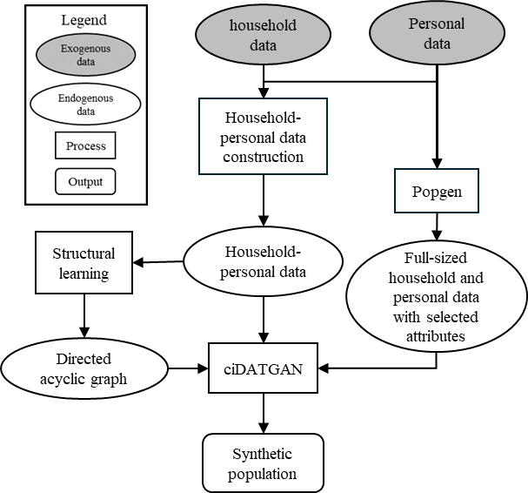
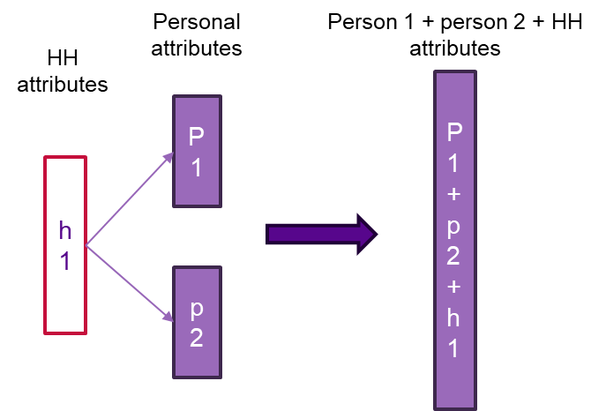
Methodology - Inputs
Sample input preparation
Append all household members' attributes to the corresponding household attributes
Prepare full-sized data with selected attribute using traditional method as conditional input (e.g., age, race)

Slide 7
Methodology – Model Training
Model training process
Learn the directed acyclic graph (DAG) that depicts the correlations between attributes of the target data (regularization)
Use the input data, DAG, and the attributes selected as conditional input to train the ciDATGAN model
ciDATGAN: a generative adversarial network (GAN) model tailored to generate tabular data with added regularization

Slide 8
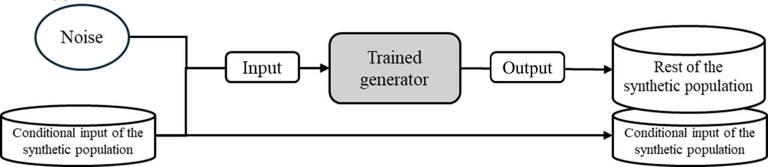
Methodology – Population synthesis
Generating synthetic population
Use the full-sized conditional input and the trained ciDATGAN model to generate synthetic population
Attributes grows from the conditional input attributes based on the learned structure from the sample input

Slide 9
NYS
Synthetic Population

Slide 10
Data Source
PUMS from 2021 5-year ACS
956,365 individuals and 423,149 households from 2017 to 2021 after data cleaning
Expecting consistent associations among attribute associations
The conditional inputs uses the post COVID information only (attributes highlighted in yellow)
 | Non-NYC region attribute (label name) | No. of values (range if continuous) | NYC region attribute (label name) | No. of values
Household attribute | Residence area (PUMA) | 90 | Residence area (CT) | 2313
 | Income level (HINCP) | 9 | Income level (HINCP) | 9
 | Vehicle ownership (VEH) | 4 | Vehicle ownership (VEH) | 4
Personal attribute | Age (AGEP) | 7 | Age (AGEP) | 7
 | English proficiency (ENG) | 5 | English proficiency (ENG) | 5
 | Commute trip length (JWMNP) | 0-140 min | Gender (SEX) | 2
 | Commute mode (JWTRNS) | 13 | Disability (DIS) | 2
 | School status (SCH) | 3 | Working industry (NAICSP) | 2
 | Sex (SEX) | 2 | Race white/non-white (RACWHT) | 2
 | Disability (DIS) | 2
 | Working industry (NAICSP) | 20
 | Race white/non-white (RACWHT) | 2

Slide 11
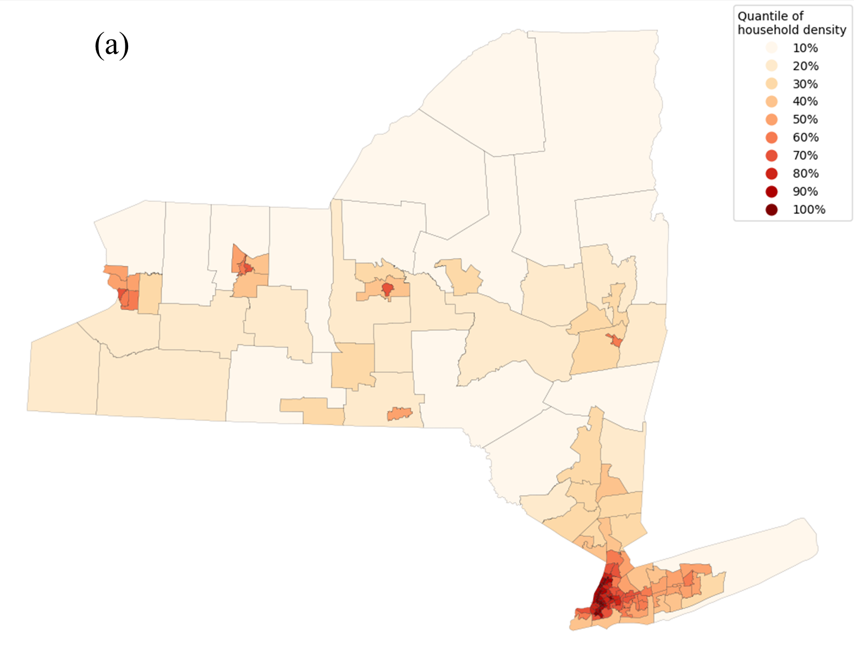
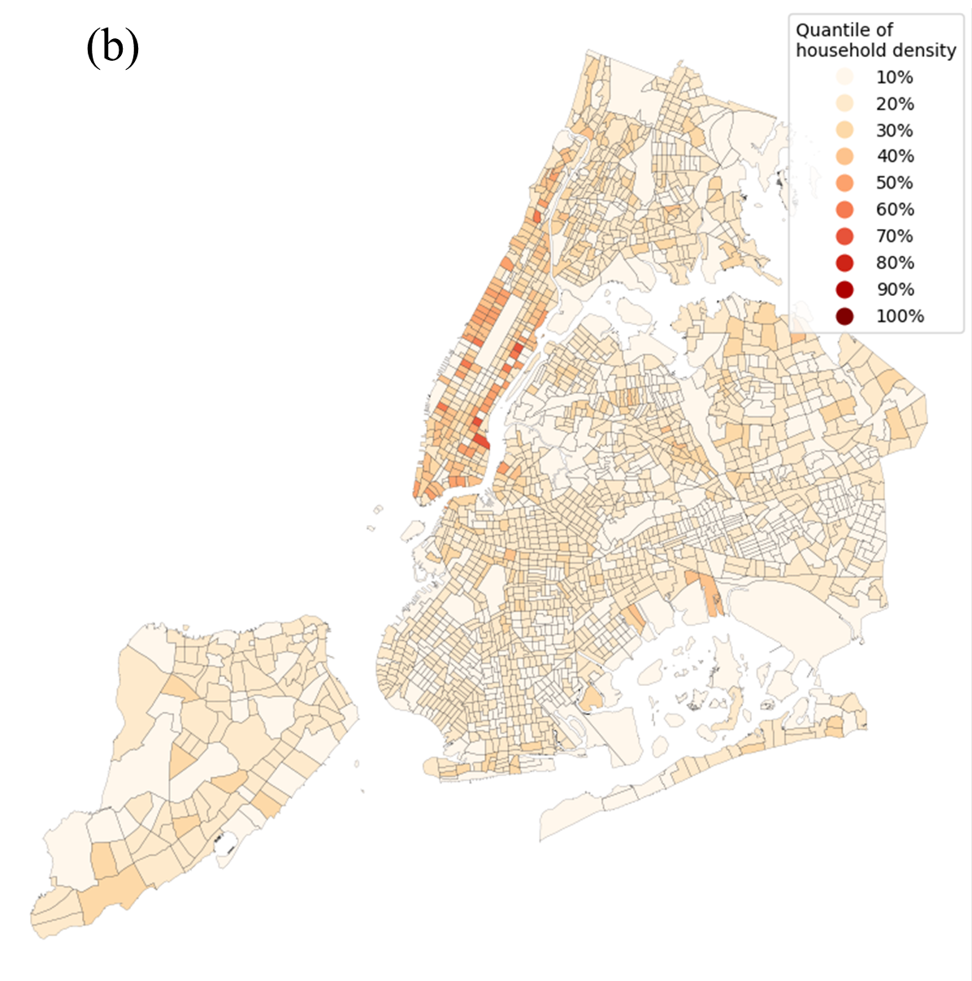
Data Source (cont.)
Density distribution of the households with less than or equal to 5 members in the input dataset in (a) NYS on PUMA level and (b) NYC on CT level

Slide 12
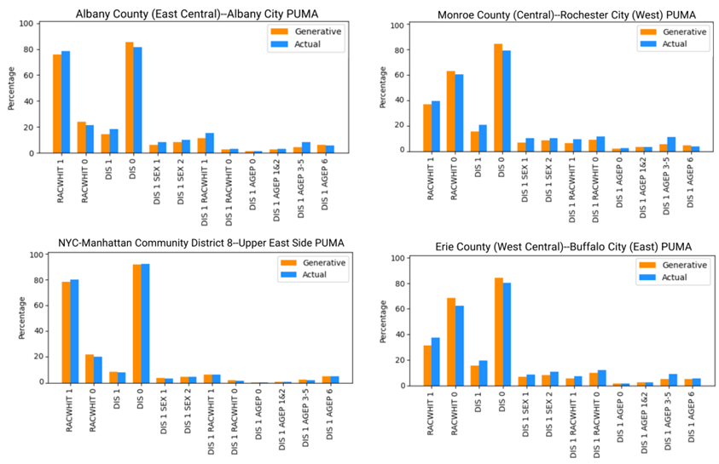
Validation – Personal Attributes
10,775,790 individuals and 4,267,578 households in non-NYC regions
8,347,978 individuals and 3,283,033 households in NYC.

Slide 13
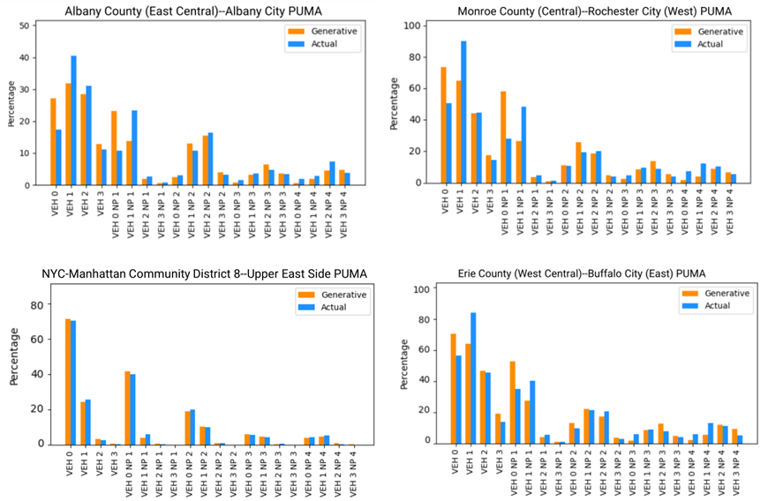
Validation – Household Attributes
10,775,790 individuals and 4,267,578 households in non-NYC regions
8,347,978 individuals and 3,283,033 households in NYC.

Slide 14
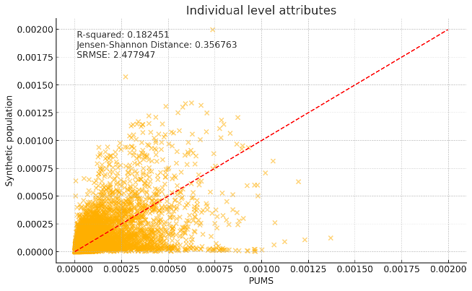
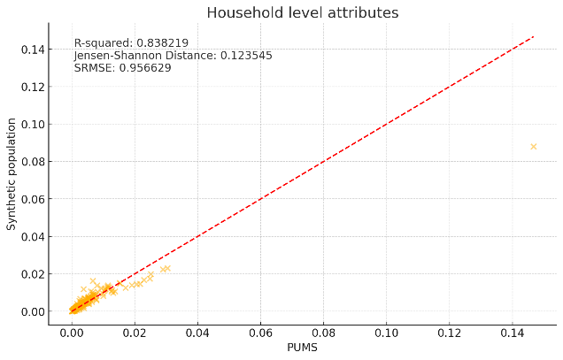
Validation – higher dimension
Joint distribution matching for combination of PUMA, age, race, gender, English proficiency, and disability (left); and combination of PUMA, vehicle ownership, number of household members, and household income level (right).

Slide 15
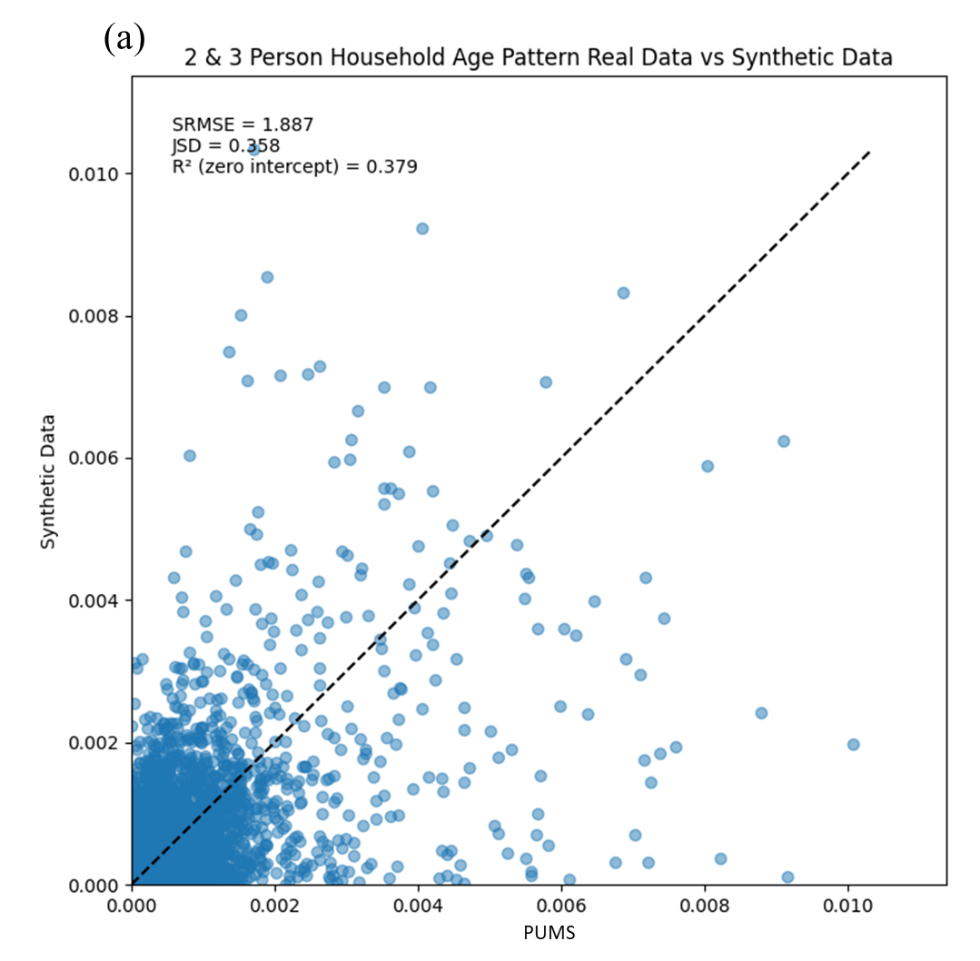
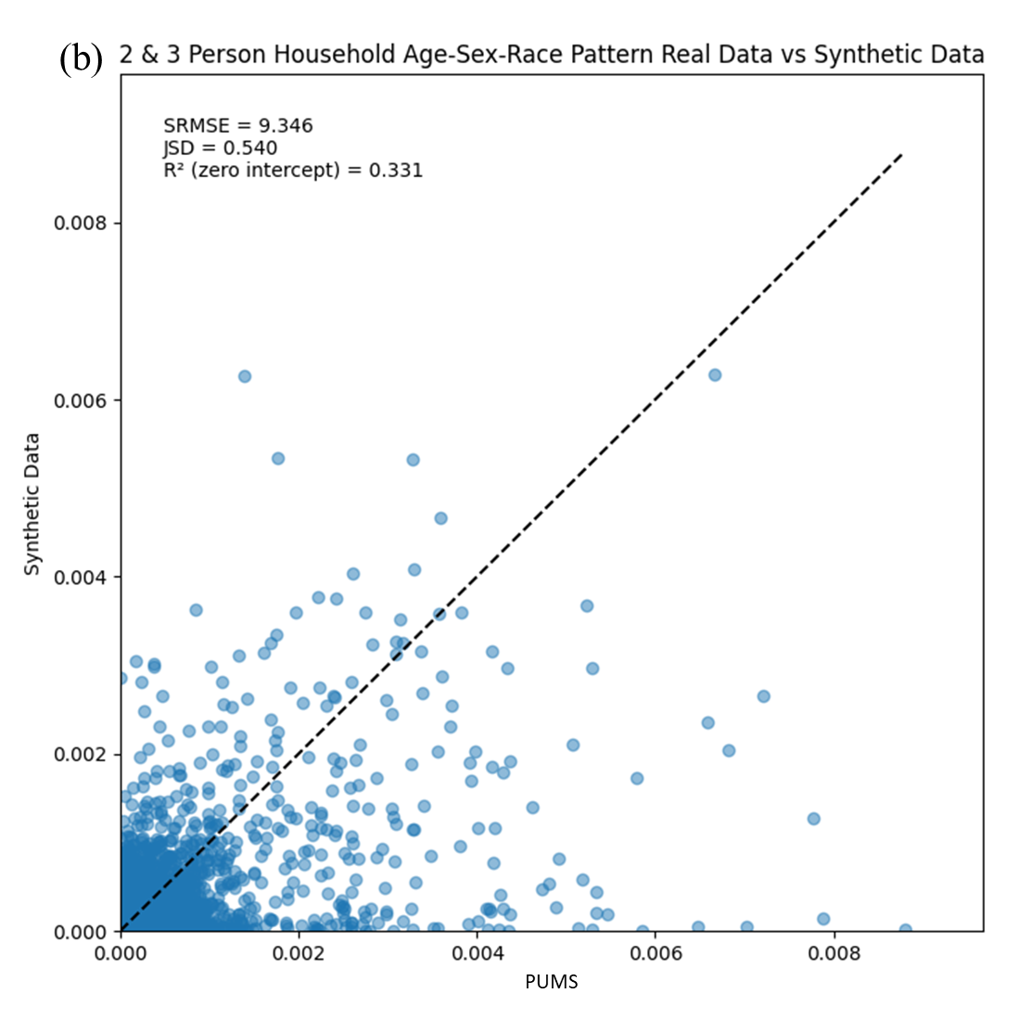
Validation – Household member associations
Joint distribution matching for combination of 2 and 3-person household members’ (a) age and (b) gender.

Slide 16
Diversity of household structure
The sample data only represents part of the population
We also want the synthesized household to have more diverse structure
Use 2-person and 3-person households to calculate a diversity score
Higher diversity scores are obtained from the synthetic population
Attribute Combination | PUMS Diversity Score | Synthetic Population Diversity Score
Personal Attributes | 33.82 | 37.16
Adding household attributes | 39.91 | 46.68

Slide 17
Conclusion
We propose a model framework that combines the traditional population synthesis model and a deep learning model
The model generates a synthetic population with both household-level and personal-level attributes, improving diversity and accuracy
The generated synthetic population for New York State includes 10.77 million individuals and 4.27 million households (non-NYC) and 8.35 million individuals and 3.28 million households (NYC)
The synthetic population accurately matches the census marginals for both individual and household attributes
The model successfully preserves associations between household members, also adding diversity from the sample input

Slide 18

Potential Applications
Potential application
Urban Planning: land use and infrastructure planning
Transportation Analysis: equity in mobility
Public Health Analysis: public health resource allocation
Future work
Enhance Interdependencies: Further improving the accuracy of interdependencies among household members and attributes
Statewide Activity Agenda: The synthetic population can serve as the foundation to develop a comprehensive statewide agenda that includes typical daily activities for individuals

Slide 19
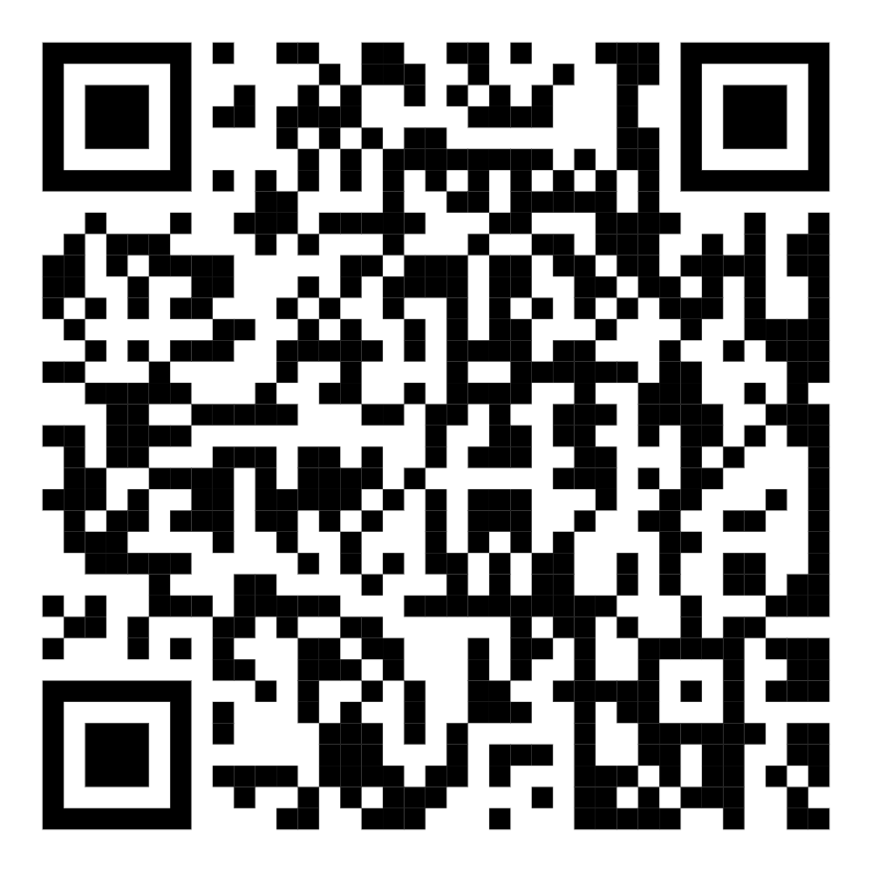
Thank you
Scan the QR code for the full dataset!

