Slide 1

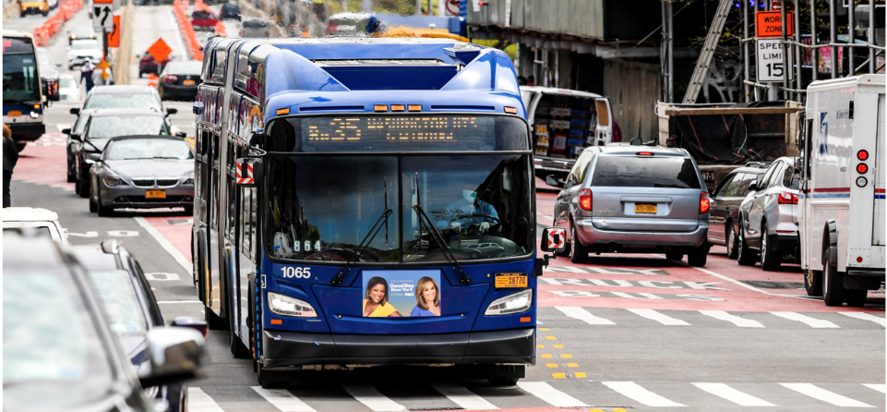
Defining and Measuring Transit Equity
September 20, 2024

Slide 2
What is Equity, How Do We Apply to Transit?
Equity: the fair and just distribution of benefits and burdens of transit services, policies, and infrastructure across communities of historically disadvantaged populations
More than Title VI or the Americans with Disabilities Act
Federal laws are meant as floors, not ceilings
A method to evaluate the impact of transit beyond generic access, travel time, and budget measures
2
4

Slide 3
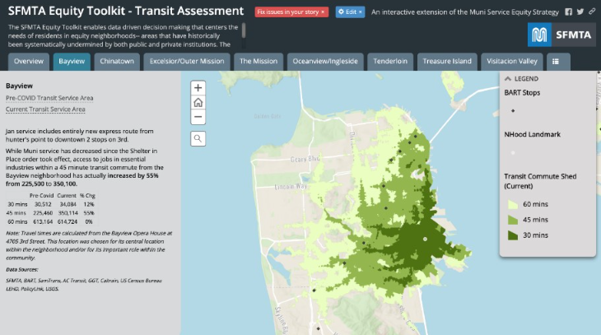
Examples from Transit Agencies
Several transit agencies have taken concrete steps to define and measure equity
SFMTA (San Francisco)
King County Metro (Seattle)
Trimet (Portland)
3
4

Slide 4
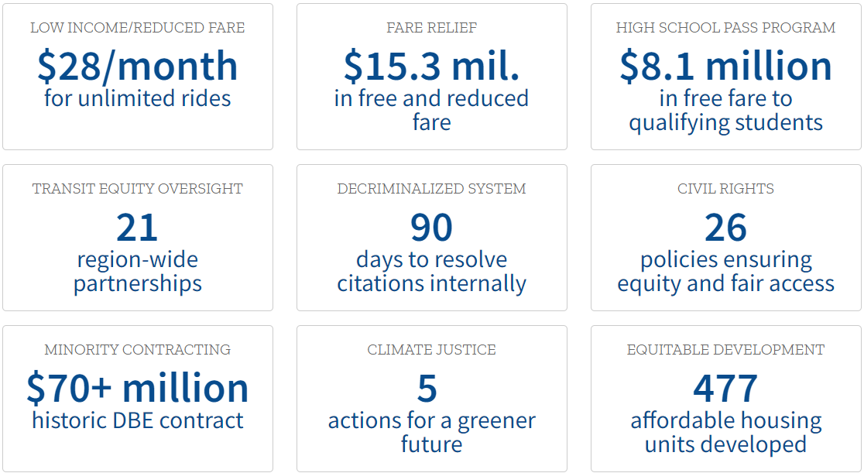
Equity: New Measure of Success
Move beyond travel time savings or ridership measures
Equity goals may justify increases in costs per boarding, reduced farebox revenue
Equity goals can spark creative thinking in providing services to meet new success criteria
4
4

Slide 5
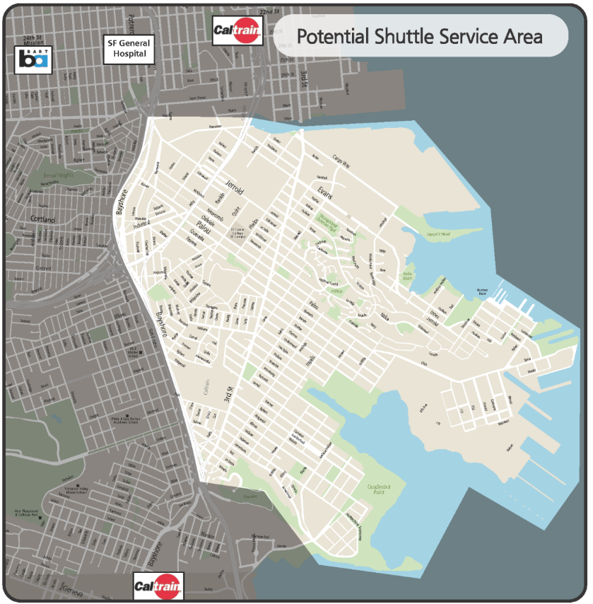
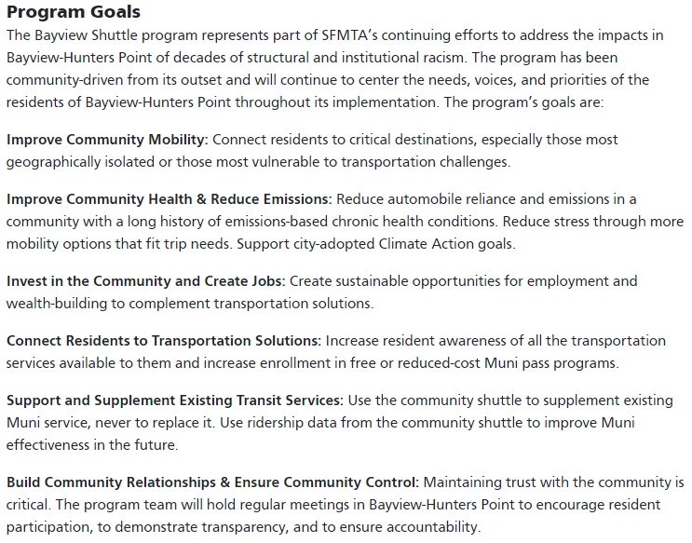
Equity: New Service Provisions
San Francisco: Bayview Shuttle
5
4

Slide 6
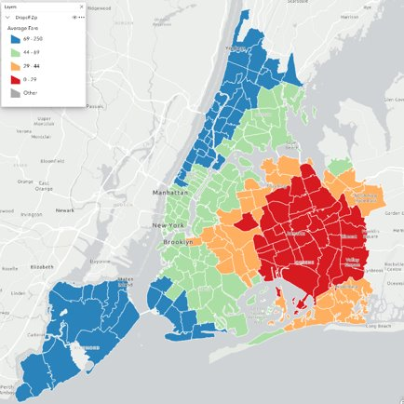
Equity: New Service Provisions
New York City Transit: Access-A-Ride E-Hail Program
On-demand paratransit
Phase 3 of program increased max fare
Program provides high level of access and potentially reduces overall paratransit costs
6
4

Slide 7
Equity: New Service Provisions
Portland: LIFT + Instacart
Piloting provision of $10/month Instacart subscription for LIFT customers
Enables customers to have groceries delivered
Significantly reduces number of LIFT trips, saving operating costs
Significantly reduces time spent to travel
7
4

Slide 8
Equity: In Summary
Traditional measures of success include ridership growth, passenger minutes saved, farebox recovery, cost per revenue hour, customer satisfaction
But these measures can push service plans towards white collar, central business district (CBD) oriented rush hours at the expense of shift work, weekend travel, and non-work but still essential travel to non-CBD areas
Incorporating equity opens up new ways of thinking about how to achieve the goals of a community and measure success
8
4

