Slide 1
NYMTC’s Non-Discrimination Framework
NYU-SEMPACT Workshop on Transportation Equity
September 20, 2024

Slide 2
A context for this presentation . . .
SEMPACT seeks to leverage:
  Recent advances in vehicle and infrastructure technologies;
  Data and modeling;
  Analytics, and visualization . . .
. . . to plan, design, implement, and operate a more equitable, resilient, and sustainable transportation system
Federal funding
for projects and
studies
Transportation Information
Gateway; Community Planning Workshops
Visualized plans & program
information
Outreach & engagement

Slide 3
Organizational Context

Slide 4
New York Metropolitan Transportation Council (NYMTC)
A metropolitan planning organization for New York City, Long Island & the Lower Hudson Valley
A regional council of governments consisting of nine voting & seven advisory members
An organization required by federal legislation which authorizes funding for transportation
An organization responsible for the mandated metropolitan transportation planning process

Slide 5
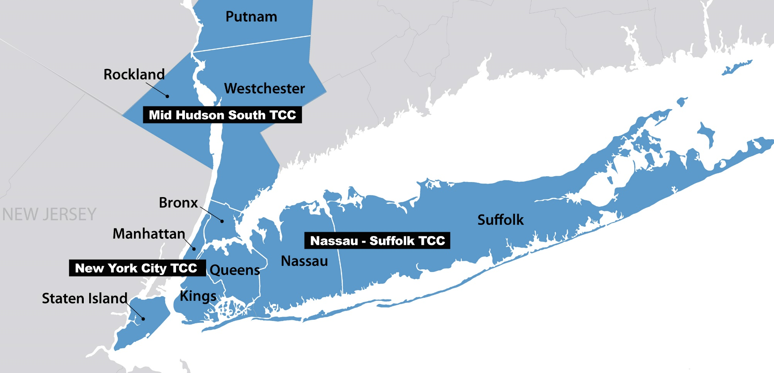
NYMTC PLANNING AREA

Slide 6

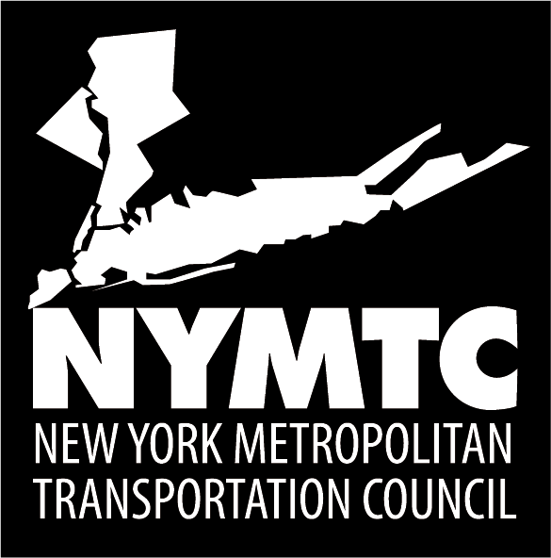











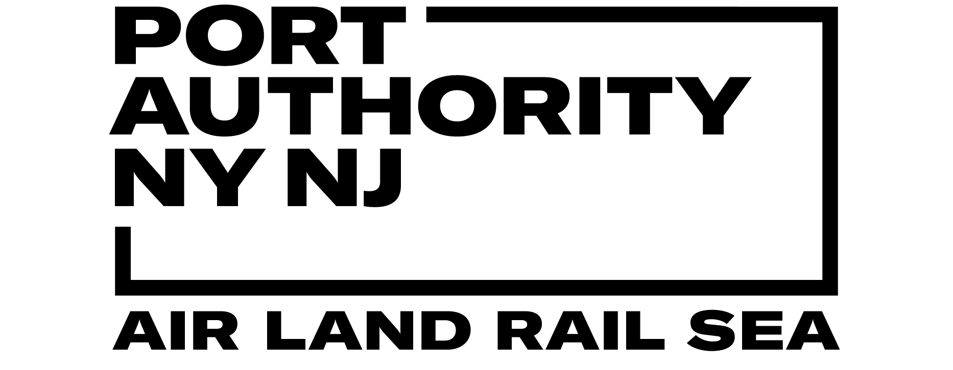

NYMTC Membership
Advisory

Slide 7
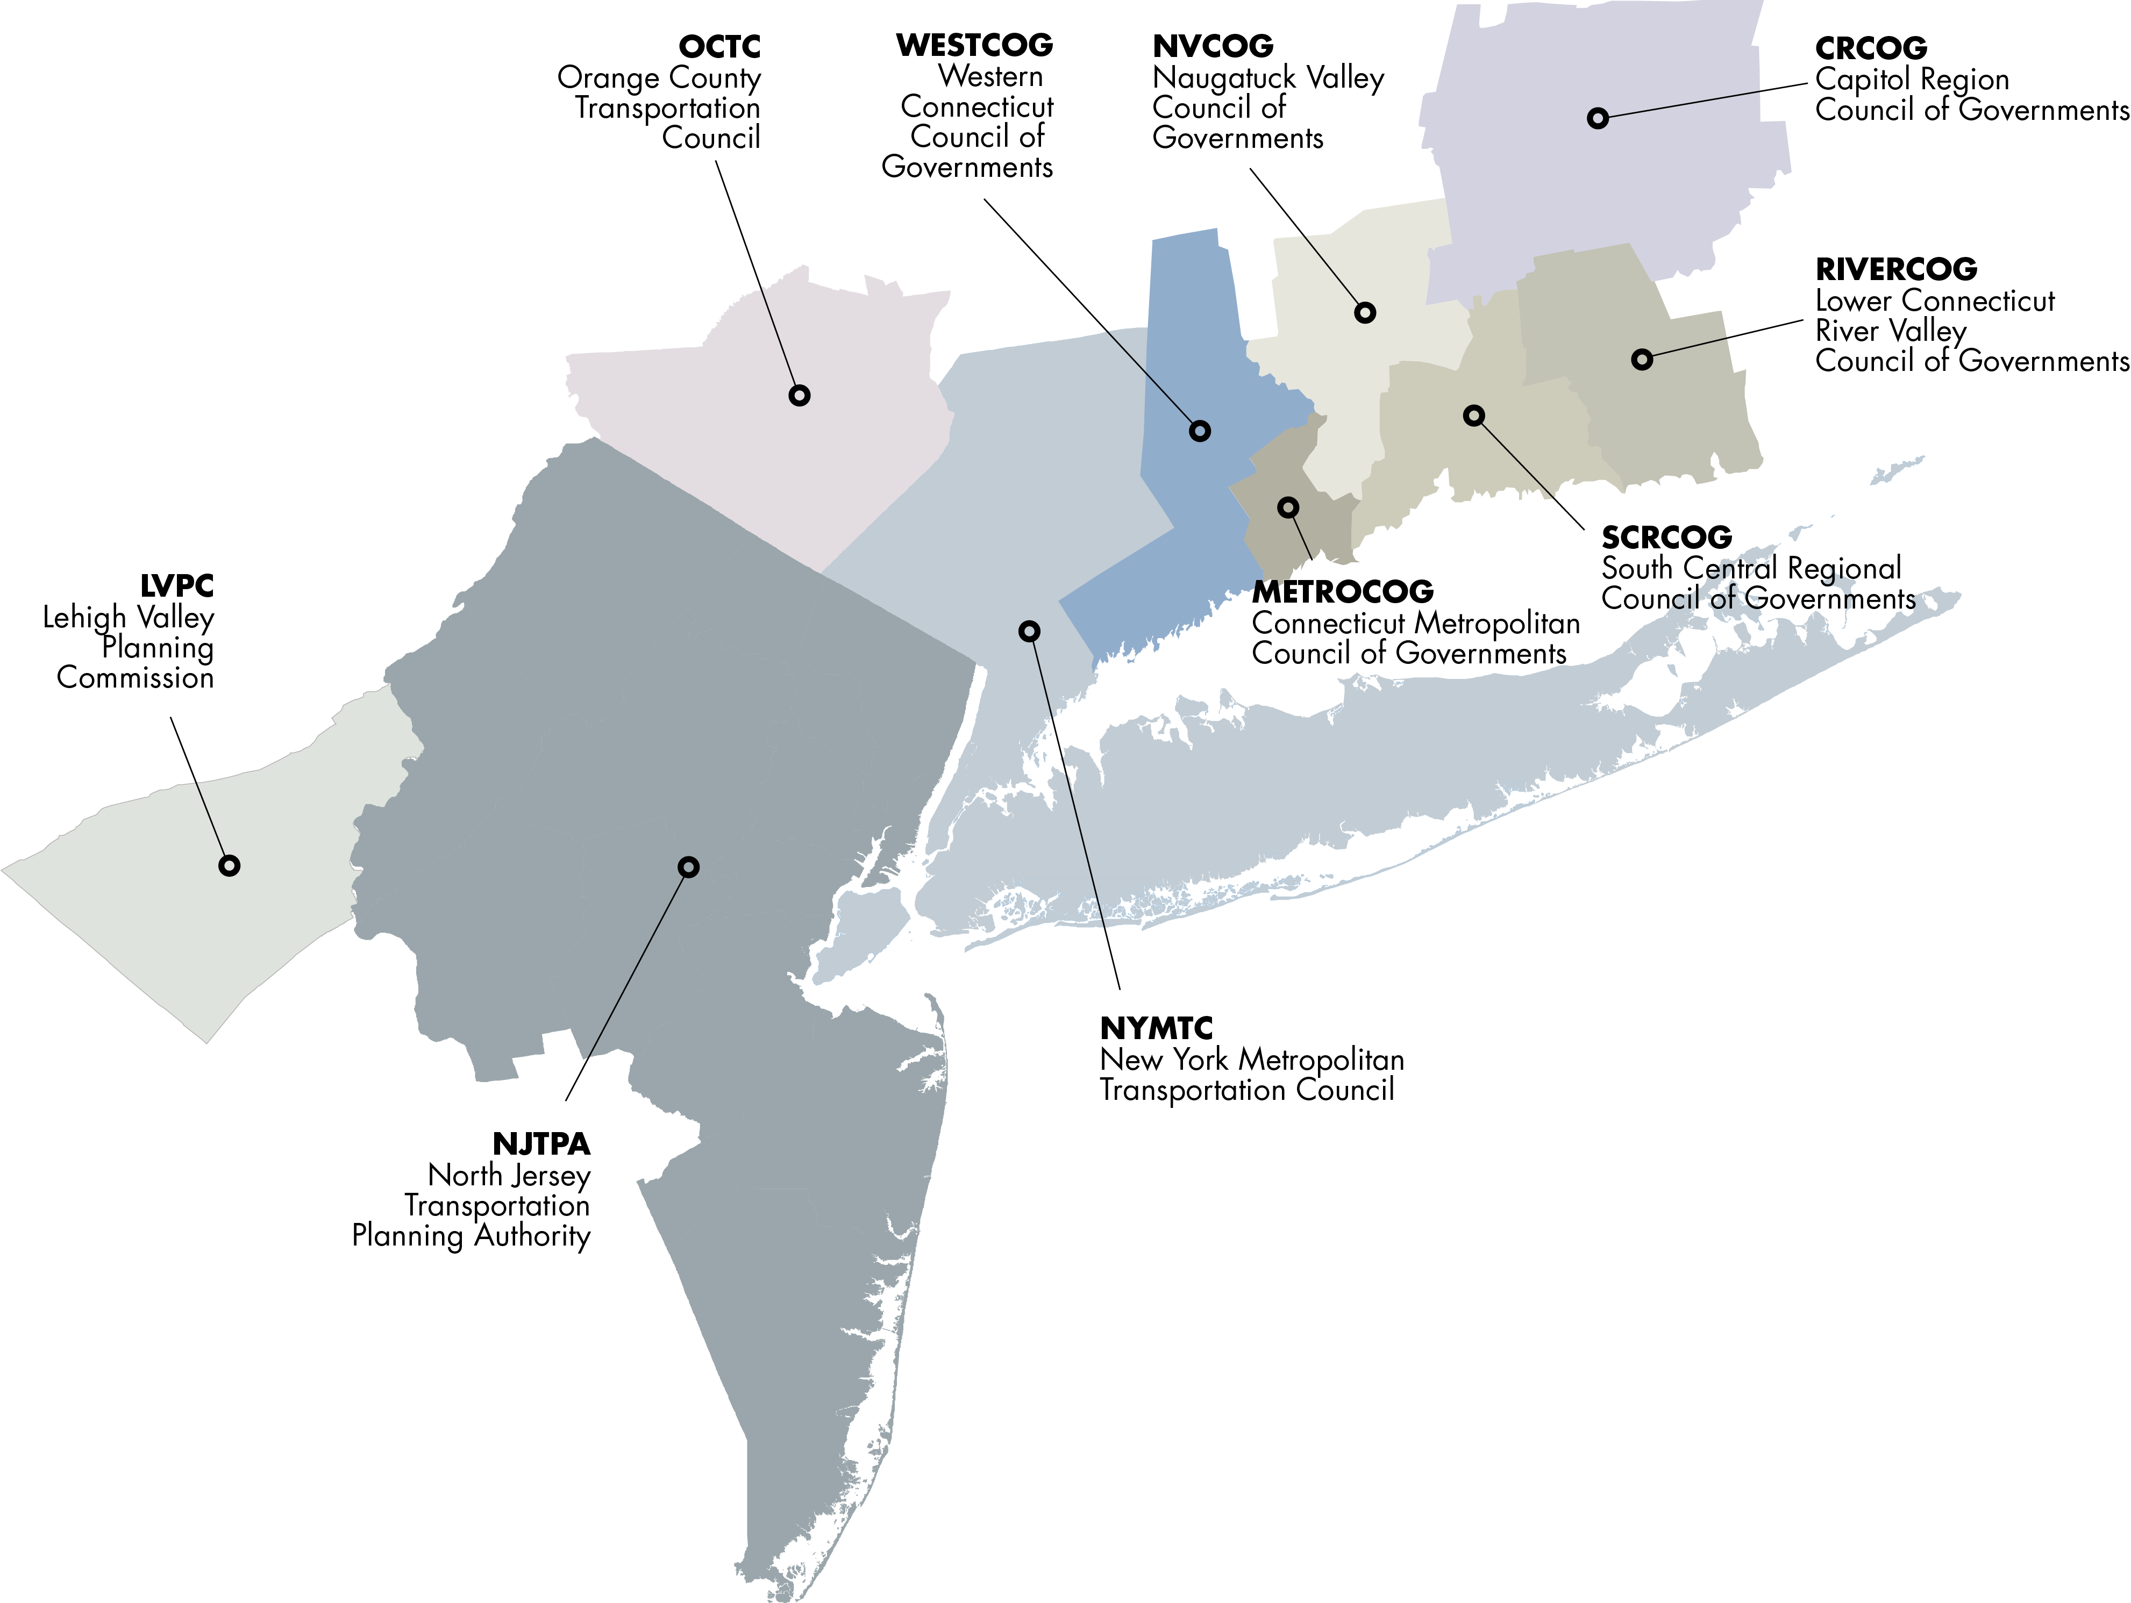
Metropolitan Area Planning (MAP) Forum

Slide 8
NYMTC’s Responsibilities

Slide 9
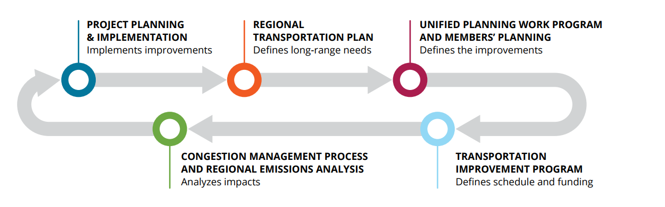
Metropolitan Transportation Planning Process
Notes:
As an MPO we are required to produce three planning products: the Regional Transportation Plan (RTP), which defines long range needs, in this case Plan 2045; the Unified Planning Work Program (UPWP), which is basically a one-year prospectus to help define improvements; and the Transportation Improvement Program (TIP), which defines schedules and funding for projects; And two planning processes – Congestion Management Process (CMP) and Regional Emissions Analysis, which analyze congestion and air quality impacts.
9

Slide 10
Non-Discrimination Policies & Programs

Slide 11
NYMTC’s Non-Discrimination Framework
Title VI/Non-Discrimination Program
  Statement of Policy
  Complaint process
  Communities of concern
  Assessment of planning process outcomes
Environmental Justice/Title VI Assessment of the Regional Transportation Plan
  Communities of concern
  Public involvement assessment
  Plan outcomes assessment

Slide 12
Title VI/Non-Discrimination Program
NYMTC’s Title VI/Non-Discrimination Program establishes a framework for compliance with Title VI of the Civil Rights Act of 1964.
  Title VI prohibits discrimination on the basis of race, color, and national origin in federally assisted programs and activities.
  Additionally, the Title VI/Non-Discrimination Program considers the requirements of:
    Civil Rights Restoration Act of 1987,
    Title II of the Americans with Disabilities Act,
    Section 504 of the Rehabilitation Act of 1973,
    Executive Order 12898 on Environmental Justice, and
    Executive Order 13166 on Limited English Proficiency.

Slide 13
NYMTC Policy Statement
NYMTC assures that no person or group(s) of persons shall, on the grounds of race, creed, color, national origin, sex, marital status, disability, age, sexual orientation or income level, be excluded from participation in, be denied the benefits of, or be otherwise subjected to discrimination through the federally mandated metropolitan transportation planning process undertaken by NYMTC, whether the activities are federally funded or not.

Slide 14
Special Emphasis Areas
Public access to the planning process
Outcomes of the planning process in terms of funding programmed for projects, programs and studies
Use of professional services to assist in the execution of the planning process

Slide 15
Assessment Framework: Communities of Concern
Census tracts that meet the following thresholds related to minority status and income:
  Minority population, as defined in the U.S. Census, makes up more than 57 percent (the NYMTC planning area average) of the tract population; and
  More than 14 percent (the NYMTC planning area average) of the total population live in households at or below the poverty level as defined in the U.S. Census.
  Interactive map: https://arcg.is/GCfrO
Of the 3,081 census tracts in the NYMTC planning area, 31 percent were identified as meeting these thresholds, translating to 962 individual census tracts.

Slide 16
Public outreach & involvement
NYMTC’s public engagement strategies are guided by:
  Public Involvement Plan,
  Public Involvement Operating Procedures,
  Title VI/Non-Discrimination Program, and
  Language Access Operating Proicedures.

Slide 17
Public outreach & involvement
Methods and tools for reaching CofC:
  Virtual focus groups & interactive workshops; on-site pop-up sessions; partnership with community-based organizations; use of online survey platforms to address demographic gaps
  Thriving Communities Network launched in conjunction with the USDOT’s Thriving Communities Program to support organizations working in or representing underrepresented community.
  Community Planning Workshops to assist local communities with ways to tap into available federal funds.
  Transportation Information Gateway is an interactive, collaborative website that provides NYMTC members and the public with an easily accessible online warehouse.
  Plan/Program visualization - https://arcg.is/10vrDW0

Slide 18
Planning process outcomes
There are no specific federal standards for conducting a Title VI/non-discrimination-related assessment of an MPO’s planning process outcomes.
For this purpose, NYMTC has developed an approach to assess the impacts of the planning process on minority populations and low-income communities for which geo-spatial information can be accessed.

Slide 19
Comparative analyses
Community characteristics
Characteristic | CofC | All Other
Population | 33% | 67%
Land Area | 5% | 95%
2050 weekday peak period VMT | 21% | 79%
Weekday VMT per capita | 2.3 | 4.3

Slide 20
Comparative analyses
Mobility characteristics
Journey to work | CofC | All Other
Public transit | 60% | 34%
Vehicle | 26% | 52%
> 1 hour | 37% | 30%
< 30 minutes | 24% | 30%

Slide 21
Comparative analyses
Programmed funding & projects
Metric | CofC | All Other | Both
Programmed funding | 13% | 13% | 74%
Funding per 100,000 (millions) | $758 | $381 | N/A
Census tracts with programmed projects | 55% | 33% | N/A

Slide 22
Examples of Federal Funding for Projects and Studies

Slide 23
Clean Freight Corridors Planning Study
Inventoried existing alternative fuel infrastructure in the region;
Reviewed current and emerging alternative fuel technologies;
Identified gaps between existing and future alternative fuel infrastructure;
Analyzed goods movement trends and forecasts;
Assessed goods movement impacts on communities of concern;
Identified and defined optimal corridors for recommended designations as clean freight corridors; and
Identified needs for the development of additional clean freight infrastructure in each corridor.

Slide 24
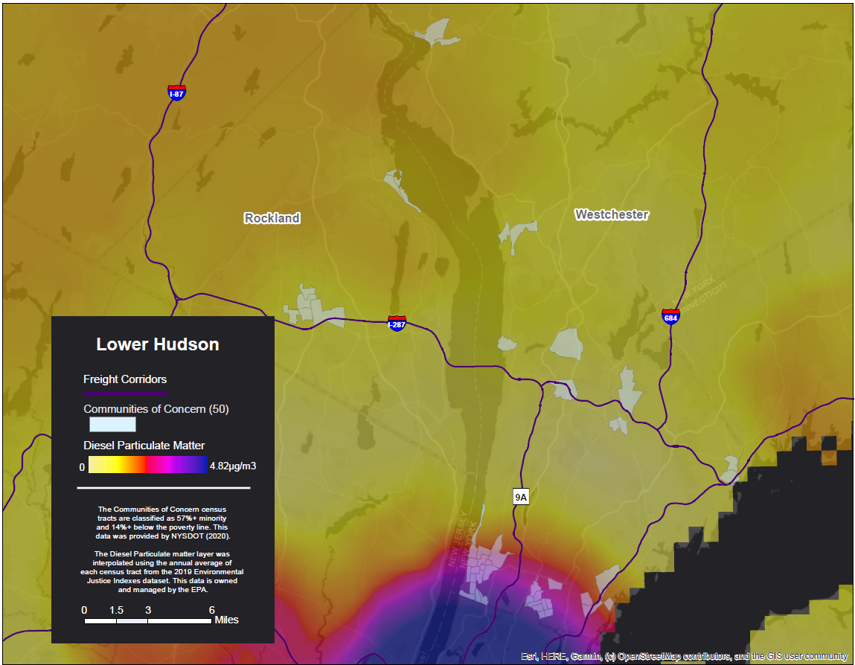
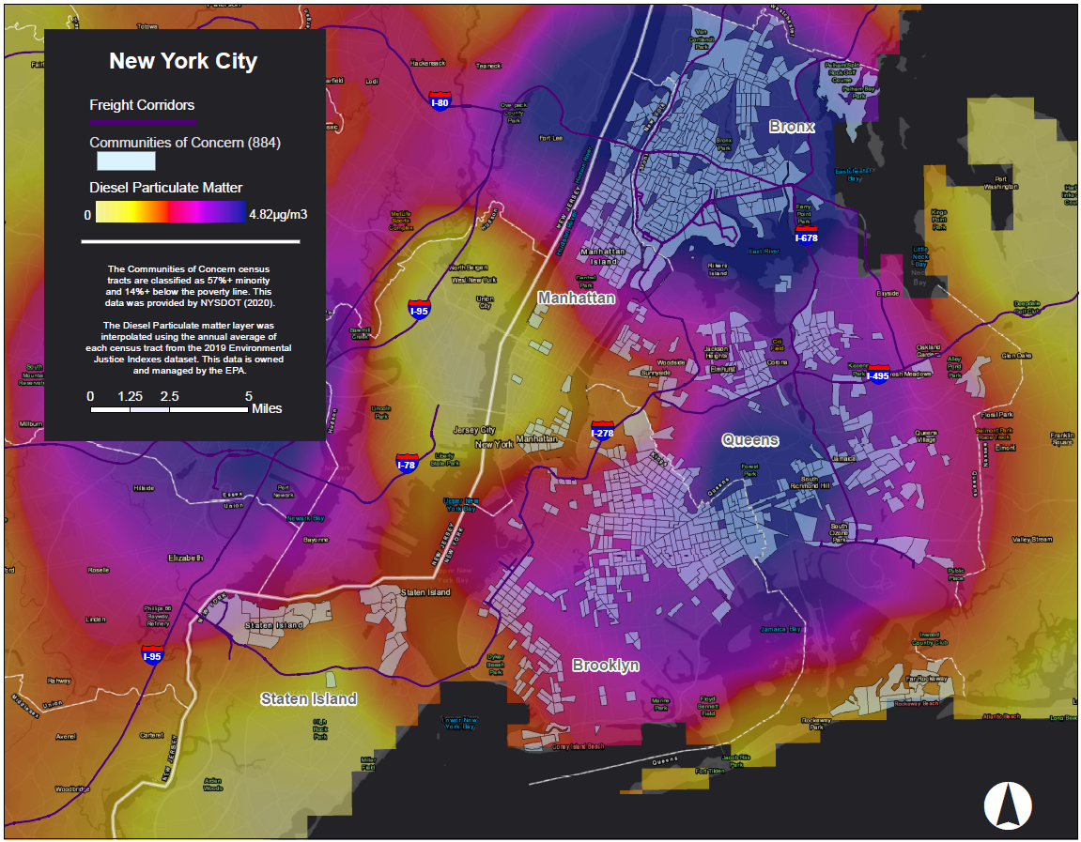
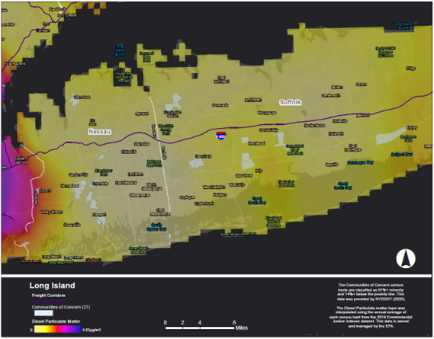
Diesel Particulate Emissions & Communities of Concern

Slide 25
Key Findings
Trucks constitute a significant source of greenhouse gas and criteria air pollution with a disproportionate impact on low-income communities
Freight volumes in the region are projected to grow 37% between 2018 and 2045
Diesel is projected to fall below 50% of new truck sales between 2029-2034, with battery electric, fuel cell electric, and compressed natural gas constituting the majority of truck sales past 2030
There is significant policy support for diesel alternatives throughout the study region but additional measures are needed to support alternative fuel fleet turnover

Slide 26
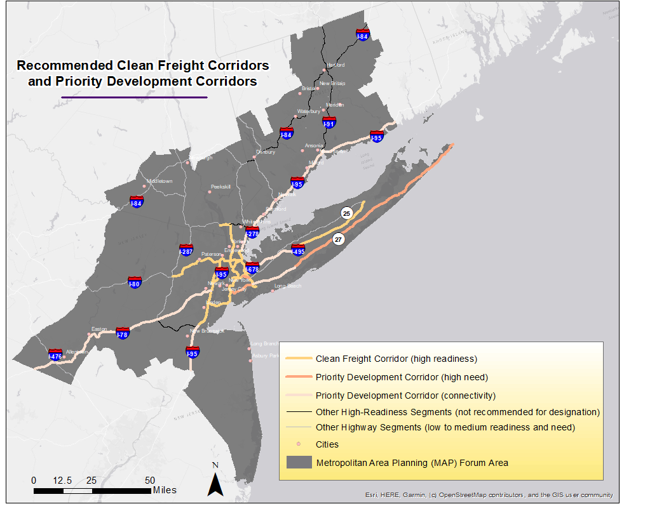

Slide 27
Implementation Steps
Potential heavy-duty EV & fueling Locations
Locations that currently or potentially could serve large commercial vehicles
Focus on proximity to corridors identified through the Clean Freight Corridor Study

Slide 28
New York City Initiatives
Clean Trucks Program
Expanding on the success of the Hunts Point Clean Trucks Program
Incentivizes local commercial fleet operators to transition away from diesel
Commercial Cargo Bike Incentive Program & freight microhubs buildout
Infrastructure upgrades for marine freight
Truck charging & parking infrastructure
Rail access and electrification improvements at the Hunts Point Market

Slide 29
Questions?

